Slide 1
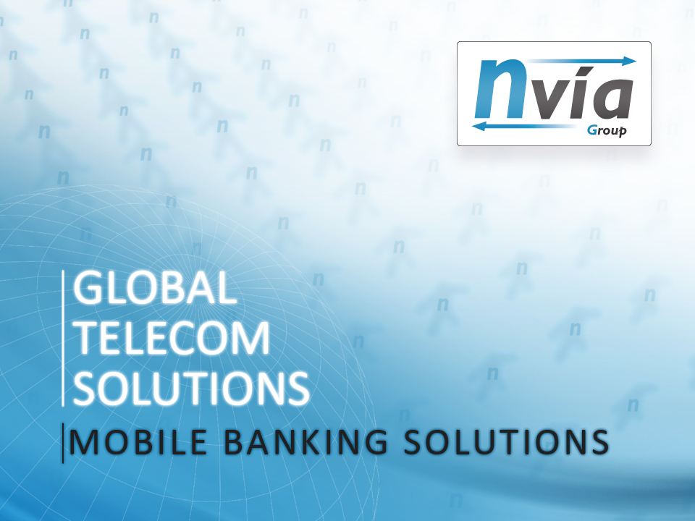

Slide 2
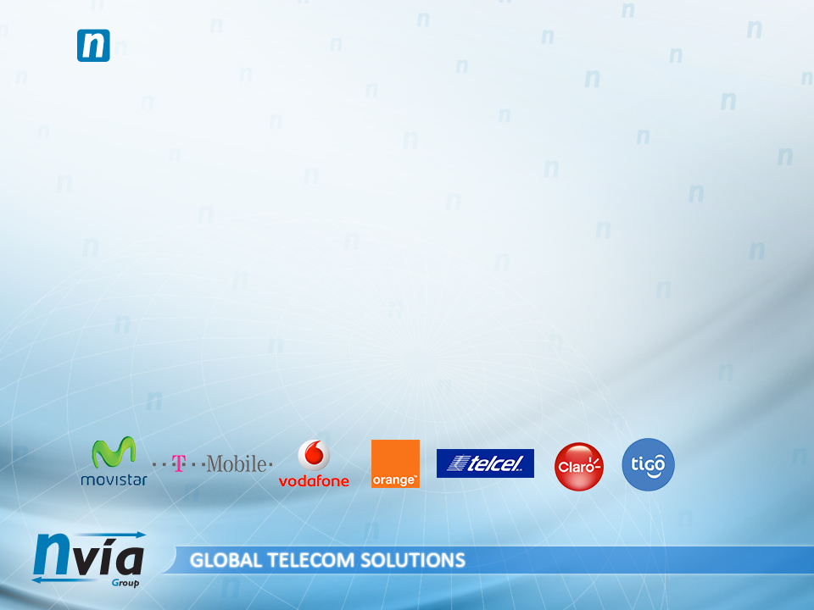

THE NVIA GROUP: ABOUT THE NVIA GROUP
Founded in Madrid in 2001, NVIA is a worldwide model in SMS & Voice services and online & mobile marketing
Direct connectivity with telecom operators in 30 countries
+ 2.000 international clients
137 million SMS delivered per Day
NVIA condenses in one company all the know-how, experience and security that your company needs
More than 10 years of experience
SMS, WAP, VOICE, WEB, USSD, APPS, EMAILING, SEO, SEM… 14 marketing services in one single company
Deep knowledge of local markets
24/7 Support

Slide 3
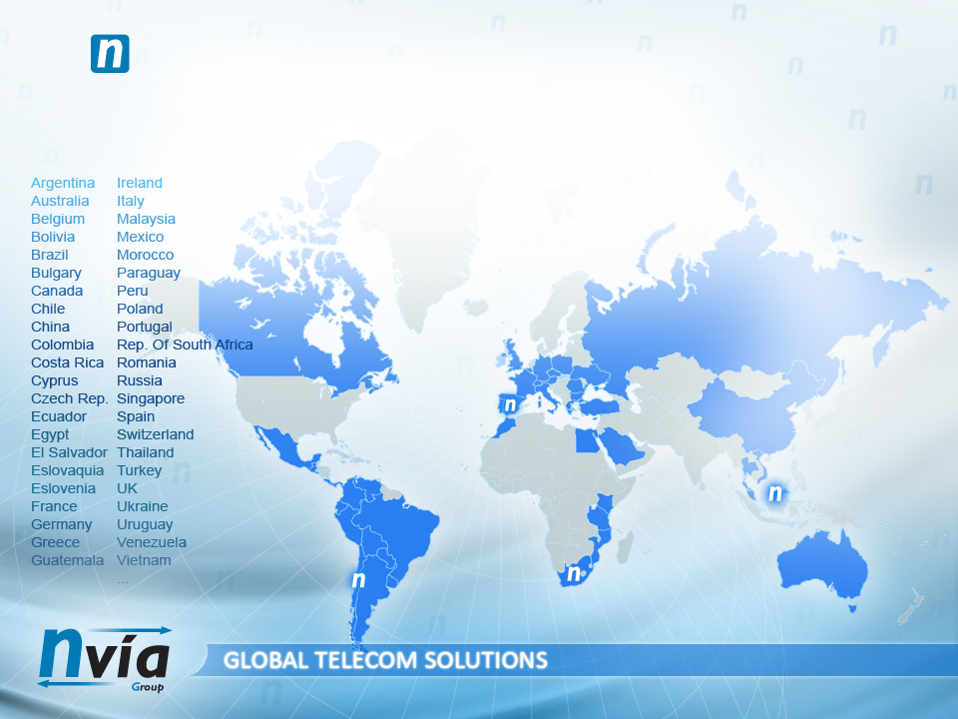

THE NVIA GROUP: WORLDWIDE PRESENCE, WORLWIDE SERVICE
Headquarters in Madrid, Santiago de Chile, Singapore and Johannesburg
+180 multidisciplinary employees in 17 offices across 4 continents

Slide 4
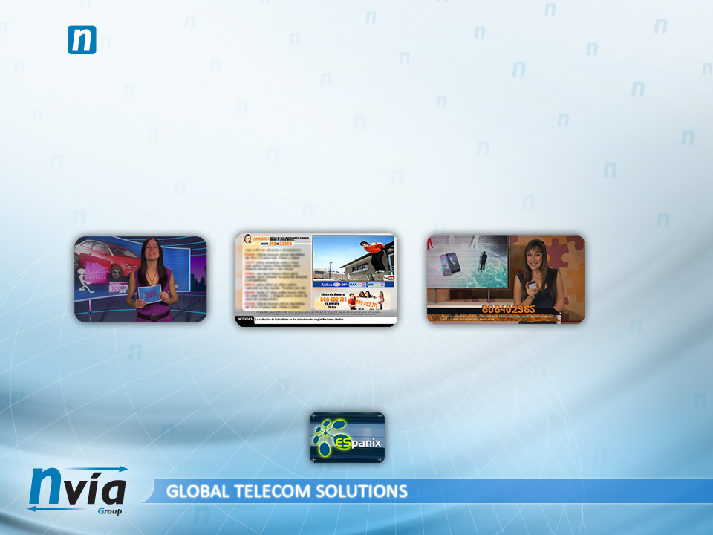
THE NVIA GROUP: SERVICES (1/3)
SMS SERVICES
World specialist in Premium and Bulk SMS
Provider and developer of cutting-edge solutions and management tools
Worldwide recognition: Microsoft, Vodafone, Movistar... use our solutions every day
SOLUTIONS
Self-developed payment platform that integrates + 3.000 payment methods
SMS and Voice TV solutions implanted all over the world: Spain, Turkey, Romania, Ecuador, Ukraine, Poland...
Global voice services that manage yearly 1 million calls and 3 million minutes
SECURITY
Our services engage the most reliable hosting and servers providers; in Spain our online quality is guaranteed through our partner Comvive, board member of Espanix
+700 operational servers, 10.000 registered domains and 50 GB broadband
Granting service continuity though 4 different internet providers: Cogent, Tiscali, NTT and Colt

Slide 5
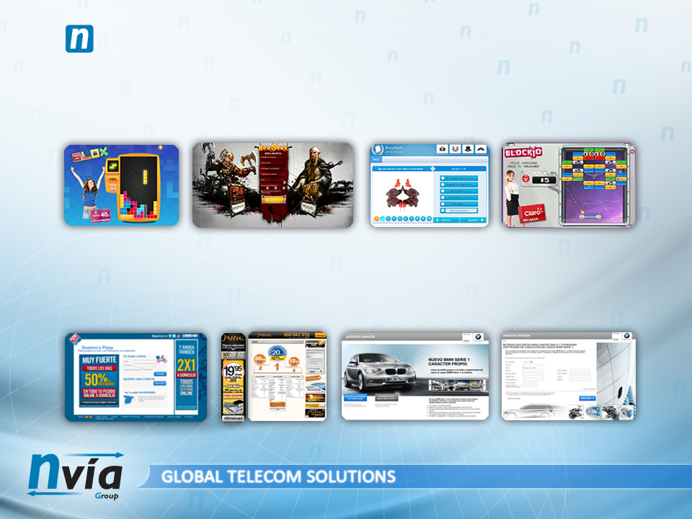
THE NVIA GROUP: SERVICES (2/3)
ADVERTISING
Our self-developed Ad Server can manage 1.200.000 daily impressions, 20% of which are mobile
Nvia is one of Spain's 15 biggest online advertisers with + € 3 million invested
We are focused on quality leads and specialised in European and Latinamerican markets. No intermediaries.
MARKETING
Our performance platform handles campaigns for Coca-Cola, BMV, Bank Positiff, BGZ Bank...
Self-developed email marketing service: retargeting, sponsoring, co-registration…
Reliable and segmented database that grows day by day: 100.000 new emails added daily

Slide 6
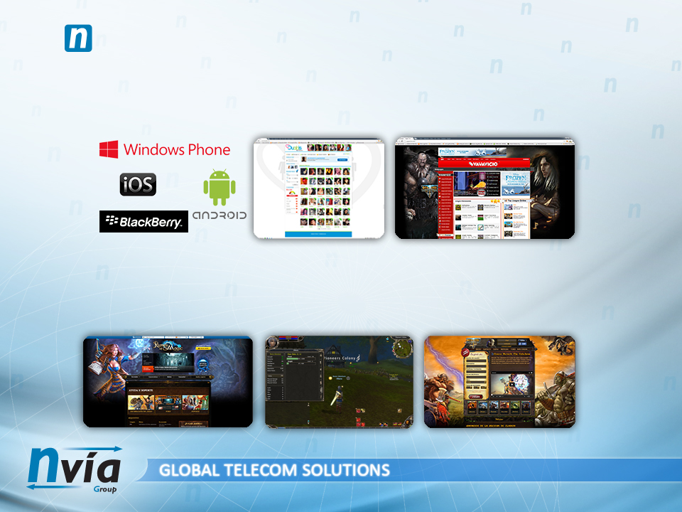
THE NVIA GROUP: SERVICES (3/3)
PRODUCT DEVELOPMENT
NVIA counts with more than 50 programmers specialized in web and app developments and cutting-edge solutions
We master mobile platforms and tablets: iPhone, Android, Blackberry, Microsoft
More than 20 designers and testers warrant the security, usability and quality of our products
CRM
24/7 support in all our products
An international customer care service grants a CRM in your local language
Our team of community managers deal with hundreds of thousands of users in different countries

Slide 7
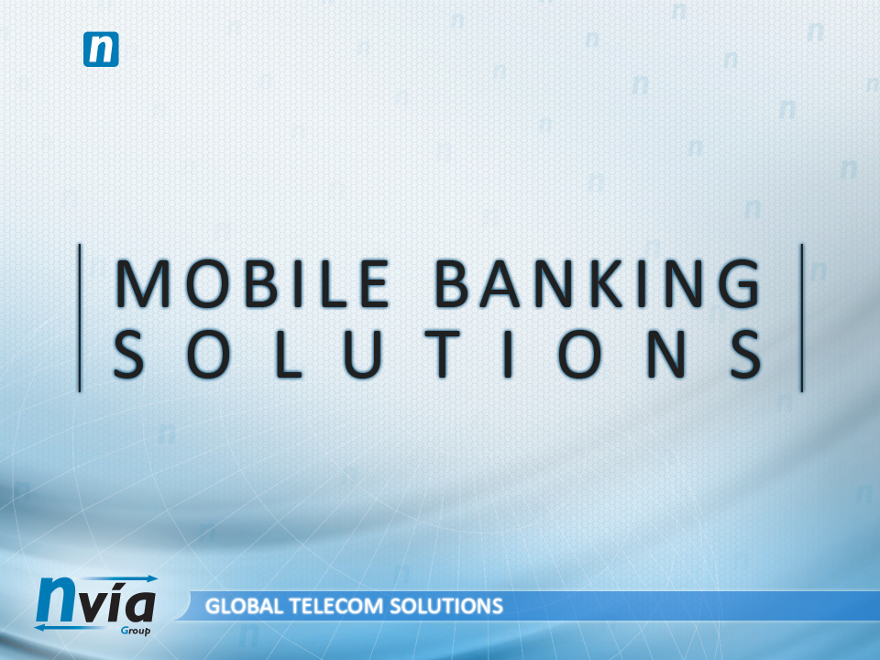
THE NVIA GROUP

Slide 8

THE NVIA GROUP: MOBILE BANKING SERVICES
Nvia's systems benefit from an abstraction layer capable of integrating data from any resource platform: web, App, ATM, USSD, WAP...
A single tool and company that enhances the service making it more robust and safe
An unified Look & Feel makes user's experience easier
Users can access their banking services from any platform. Banks configure which services will be available in each platform
Operational and/or image modifications are uniformly applied
All requests are managed from the NVIA Kernel, uniting all services in one single tool
Centralising information allows users an unified CRM service regardless of their access platform. This has a great positive impact in marketing and business development thanks to optimising statistics, communications and special offers campaigns.

Slide 9
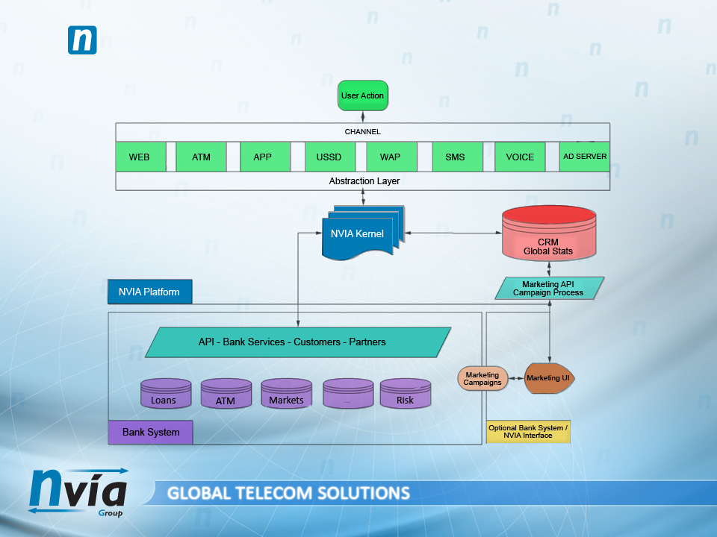
THE NVIA GROUP: NVIA KERNEL FUNCTIONAL DIAGRAM

Slide 10
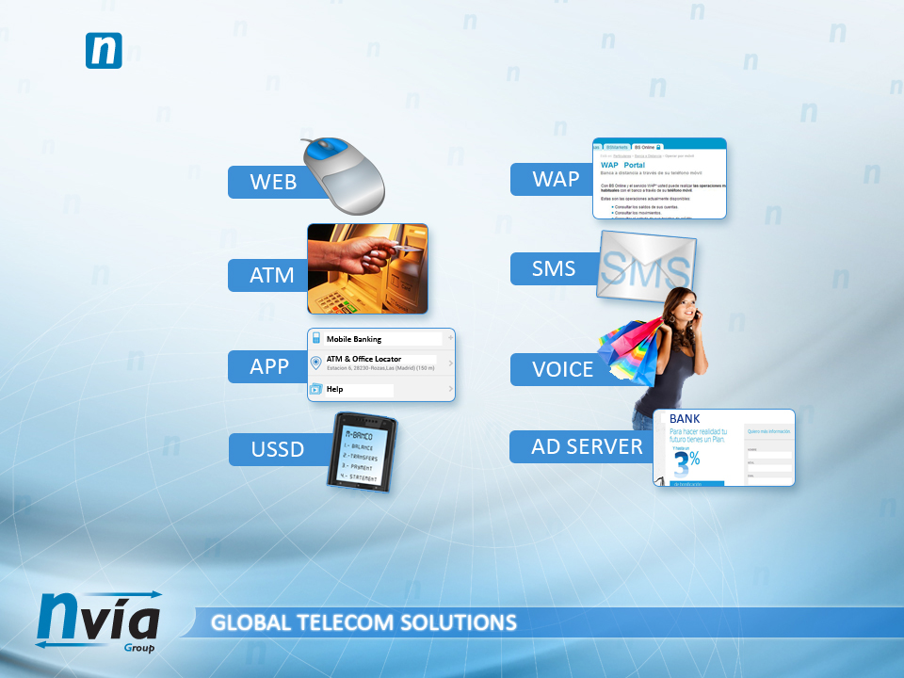
THE NVIA GROUP: CENTRALISING MOBILE BANKING SERVICES
NVIA's solutions are fully developed in-house. Simple, robust, global and modular, they can be implemented in the following areas:
Our clients choose the solution/s that suit them best; and, of course, with a complete visual identity customization

Slide 11
THE NVIA GROUP: USSD (Unstructured Supplementary Service Data)
ADVANTAGES OVER OTHER PROTOCOLS LIKE SMS:
Though similar to SMS, USSD doesn't require SMSC, it's faster, and has a lower lag time
Messages are not stored in user's device
It only requires GSM. It doesn't need 3G, GPRS, HSPA(+), WiMAX or LTE to work
The level of security in data transmissions makes it the perfect solution for making and confirming bank operations
It allows real-time atomic operations from any mobile device
Implementation is easy and it allows the inclusion of publicity between operation menus or during a given operation
INCONVENIENTS:
User must have internet connection for the communication to take place. Otherwise, the message is lost.
Implementation depends on local telecom operators.

Slide 12
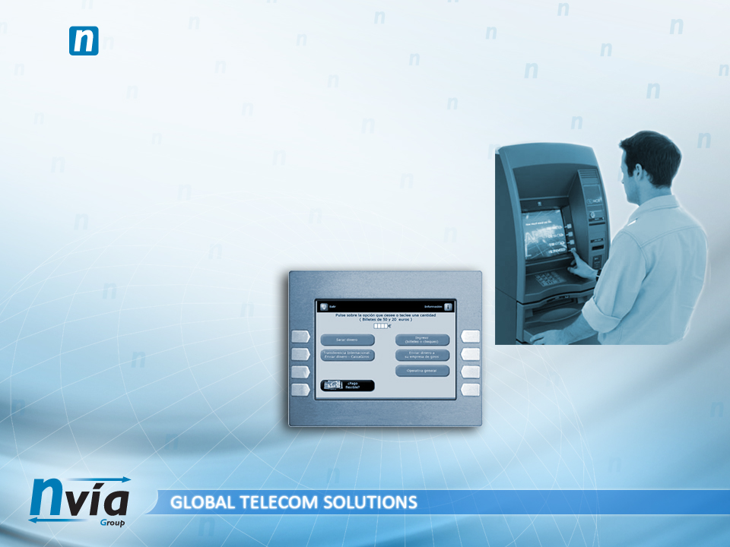
THE NVIA GROUP: ATM (Automated Teller Machine)
Thanks to more powerful servers, better software, broadband increase, easy data updating, the irruption of BI systems, Ad Server intercommunication, etc., ATM's are no longer restricted to basic operations. A safe environment for users and banks, ATM's can perform a wide range of new operations and services:
Cash withdrawal
Enquiries
• Balance
• Movements
Transfers and Sales
Bank book updates
Configuration management
Buying/withdrawing tickets
Refilling:
• Money cards
• Prepaid mobile cards
Account deposits
Public service payments
Integration of Publicity

Slide 13
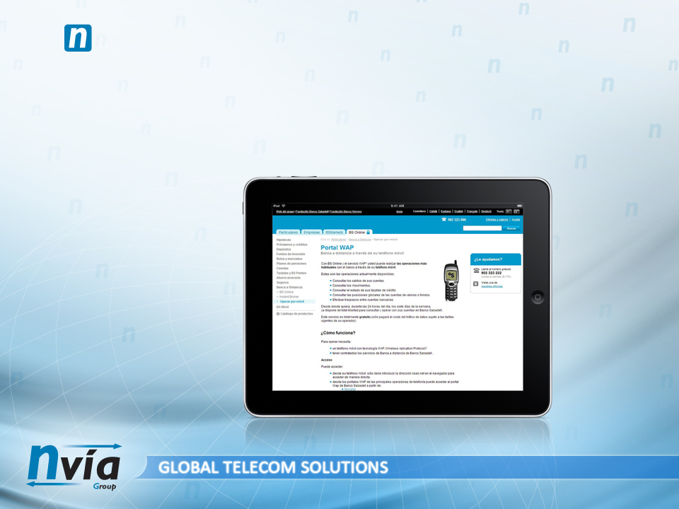
THE NVIA GROUP: WAP (Wireless Application Protocol)
WAP is an open standard protocol for wireless networks
It's most common use is to enable internet connection on mobile devices
Easily adapted to devices with limited resources, memory, processor, displays, etc.
WAP Push: It allows access to WAP content and services by sending of one or more SMS in XML format
Subscriptions
Micropayments

Slide 14
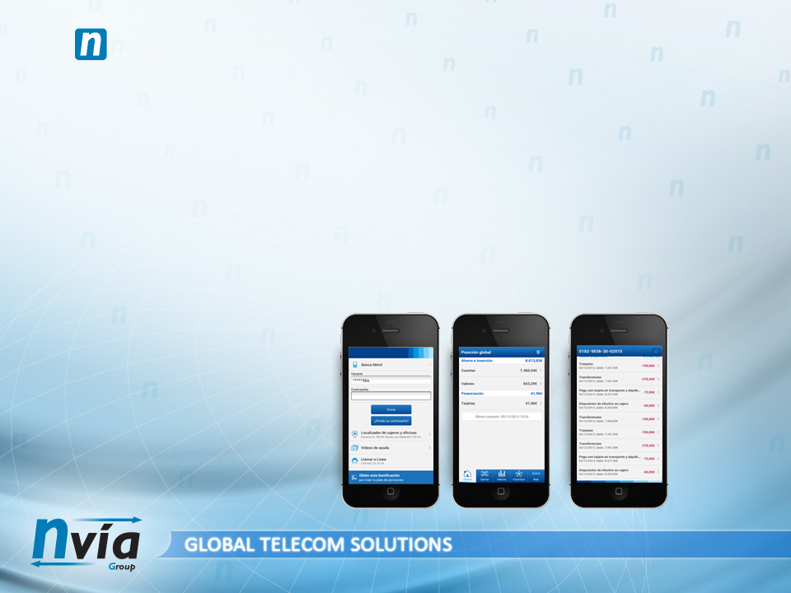
THE NVIA GROUP: MOBILE APP (Mobile Application)
The constant growth of smartphone penetration reveals the need to adapt applications to mobile telephones and tablets
In order to optimise mobile applications, they must be available for BlackBerry, iOS, Android and Windows Phone
The increase of user's trust in online banking operations creates the perfect breeding ground for mobile banking apps
Mobile apps can develop high levels of banking product's usability
Mobile apps enable banks to develop their operations beyond physical offices
Mobile apps can include à la carte publicity, thus increasing the effectiveness of advertising and new product launchings
Better service quality: the bank will be available for their clients 24/7/365
Decreases operating costs

Slide 15
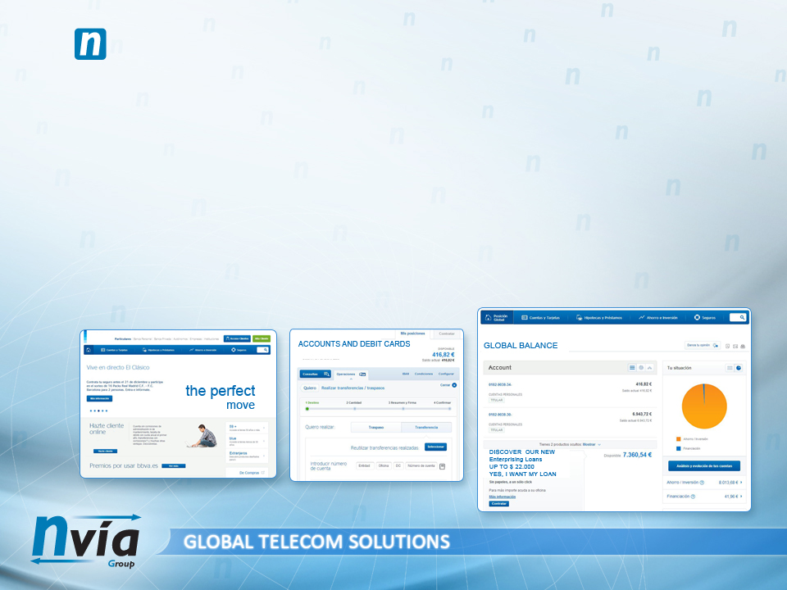
THE NVIA GROUP: ONLINE BANKING
User's trust in online banking is increasing thanks to SSL certificates, digital signatures, and security measures as combining several access channels to identify user (SMS, PIN codes, Web codes, etc.)
Self-sufficiency: user manages his own operations comfortably and quickly
Banks take their operations to the next level, beyond their physical offices
Internet banking can include à la carte publicity, thus increasing the effectiveness of advertising and new product launchings
Better service quality: the bank will be available for their clients 24/7/365
Decreases operating costs
The bank's web meets usability standards and requirements

Slide 16
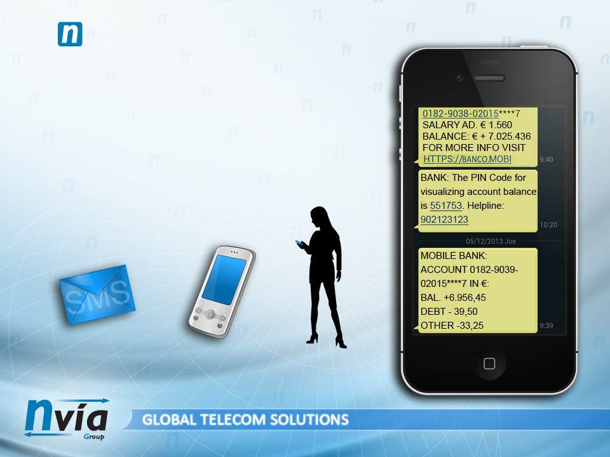
THE NVIA GROUP: SMS (Short Message Service)
Alerts: SMS enable the sending and programming of customised alerts
Reminders: SMS can serve as reminders for banking operations
Notifications: SMS can notify user about movements in accounts,
credit and debit cards
One-time operations can be confirmed by sending a PIN code in a SMS
SMS help prevent robbery
SMS can notify promotions and special offers

Slide 17

THE NVIA GROUP: IVR (Interactive Voice Response)
User can manage or automate bank operations via IVR, a technology that enables user interactivity via a phone call
Clients interact with the company's system by using their own voice (speech recognition) or by pressing buttons on their telephone keypad
IVR systems recognize a wide range of user's answers and are prepared to offer different options when in doubt
IVR is perfect for marketing actions, surveys, customer satisfaction surveys, incidents, notifying available balance, etc.
NVIA's Kernel counts with a powerful status manager that allows an easy and instant service configuration
NVIA has it's own statistical system that allows the optimization of resources, specially the ones related to customer care, thus increasing the quality of the services and decreasing operational costs

Slide 18
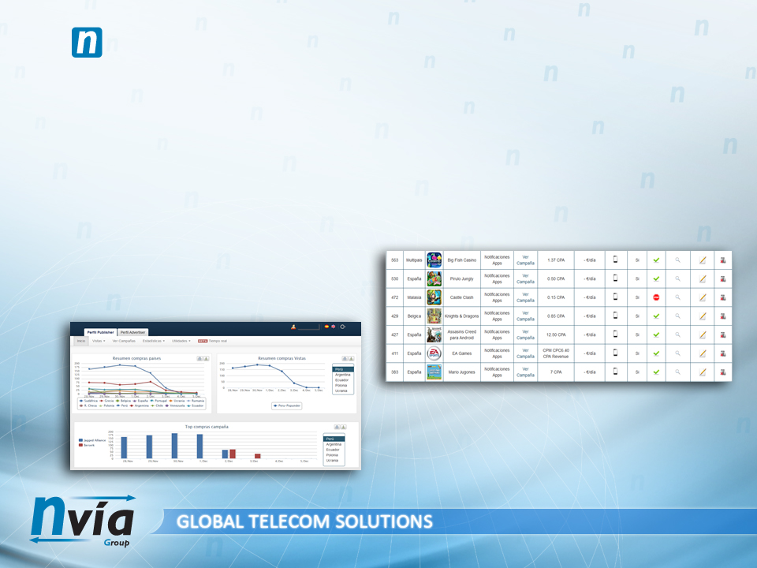
THE NVIA GROUP: Ad Server
NVIA counts with a self-developed Ad Server capable of delivering 1.200.000 impressions per day
A dedicated server manages ads in multiple portals, apps, online stores and e-commerce products
Integrated campaign management
Smart positioning of campaigns considering different display areas. Mobile networks included.
Expense optimization thanks to our system of alerts and a real-time updated control panel.
Reports and statistics

Slide 19
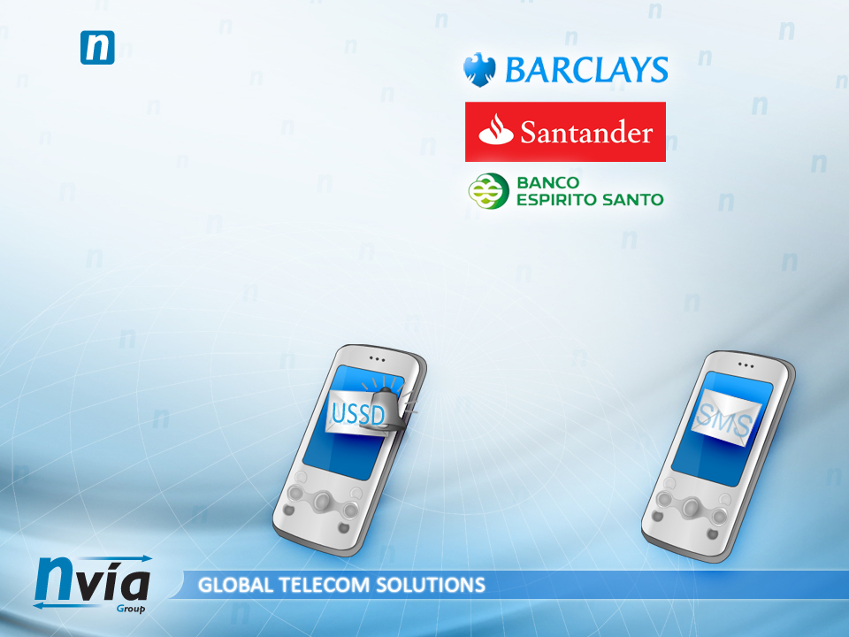
THE NVIA GROUP: SUCCESS CASES
The professionalism, quality and safety of our products have made possible for NVIA to service large multinational bank corporations such as Barclays, Santander or Banco Espirito Santo.
Better communication means better customer care. Our unique capacity of communicating instantly with our clients enhances user's experience and allows the flexible and quick solution of any problem that may occur, either by SMS, USSD, voice calls..
Promotions, payment reminders, payment notifications, balance status, brokerage activity... the possibilities of new technologies applied to banking are endless. All this at a speed of 600 SMS per second and in a safe environment that prevents personal or banking data robbery and forgery.
The receipt of your credit card ending in XXXX will be sent to your account on 05/12/2013. To unsubscribe: [web] Helpline 90XXXX500.
[Your Bank] notification at 04-DEC-13: your account XXXXXXXXXXXXXX is overdrown by $90,07. Please visit your office to regularize situation.

Slide 20
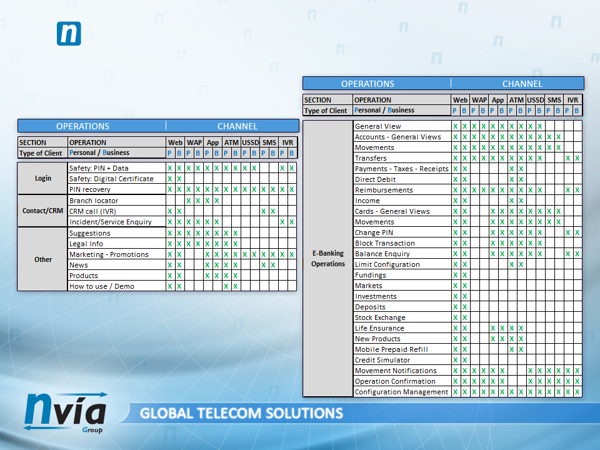
THE NVIA GROUP: OPERATIONAL TABLE – NVIA BANK SYSTEM
Operational table and example of a client’s request of Nvia's banking services

Slide 21

THE NVIA GROUP: CLIENTS

Slide 22

Should you require more info about NVIA
or any of it's business branches,
feel free to contact us.
NVIA EUROPEAN HQ
C/ La Oliva 18, 28230 Las Rozas, Madrid, Spain
info@nviasms.com
NVIA ASIAN HQ
14 Mohamed Sultan Road, #02-01 Singapore 238963
info.asia@nviasms.com
NVIA LATAM HQ
Cerro Tronador 880, Of. 3, Las Condes, Santiago, Chile
info.latam@nviasms.com
NVIA AFRICAN HQ
1ST Floor, Lancaster Gate, Hyde Park Lane
CNR William Nicol Dr. & Jan Smuts Ave. Hyde Park,
Sandton 2196, Johannesburg, South Africa
info.africa@nviasms.com

